Slide 1

Download your drugs?
Alexia Maddox, Deakin, @alexiamadd
Monica Barratt, RMIT, @monicabarratt

Slide 2
Digital Drugs: An Overview
What are digital drugs?
How do you get them?
How do they work?
The digital-body instrument
Drug parallels
The politics of pleasure
Digital drug futures

Slide 3
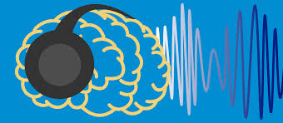
What are digital drugs?
Existing definition
Drugs that are both dependent on and substantially constituted by multiple digital representations and connections, and whose use and effectiveness is strongly mediated through digital means
Cornford and Lichtner (2014)
Our definition
Digital drugs are constituted by digital resonance that incorporates platforms, representations and connections, whose use and effectiveness is mediated through the digital-body instrument.

Slide 4
Our definition…
Digital drugs are constituted by digital resonance that incorporates platforms, representations and connections, whose use and effectiveness is mediated through the digital-body instrument.
Removes the material caveats of the previous definition by:
Introducing sound, binaural beats, through the notion of resonance.
Positions the drug as a digital artefact.
Introduces or centres the body.
So how do you get them and how do they work?

Slide 5
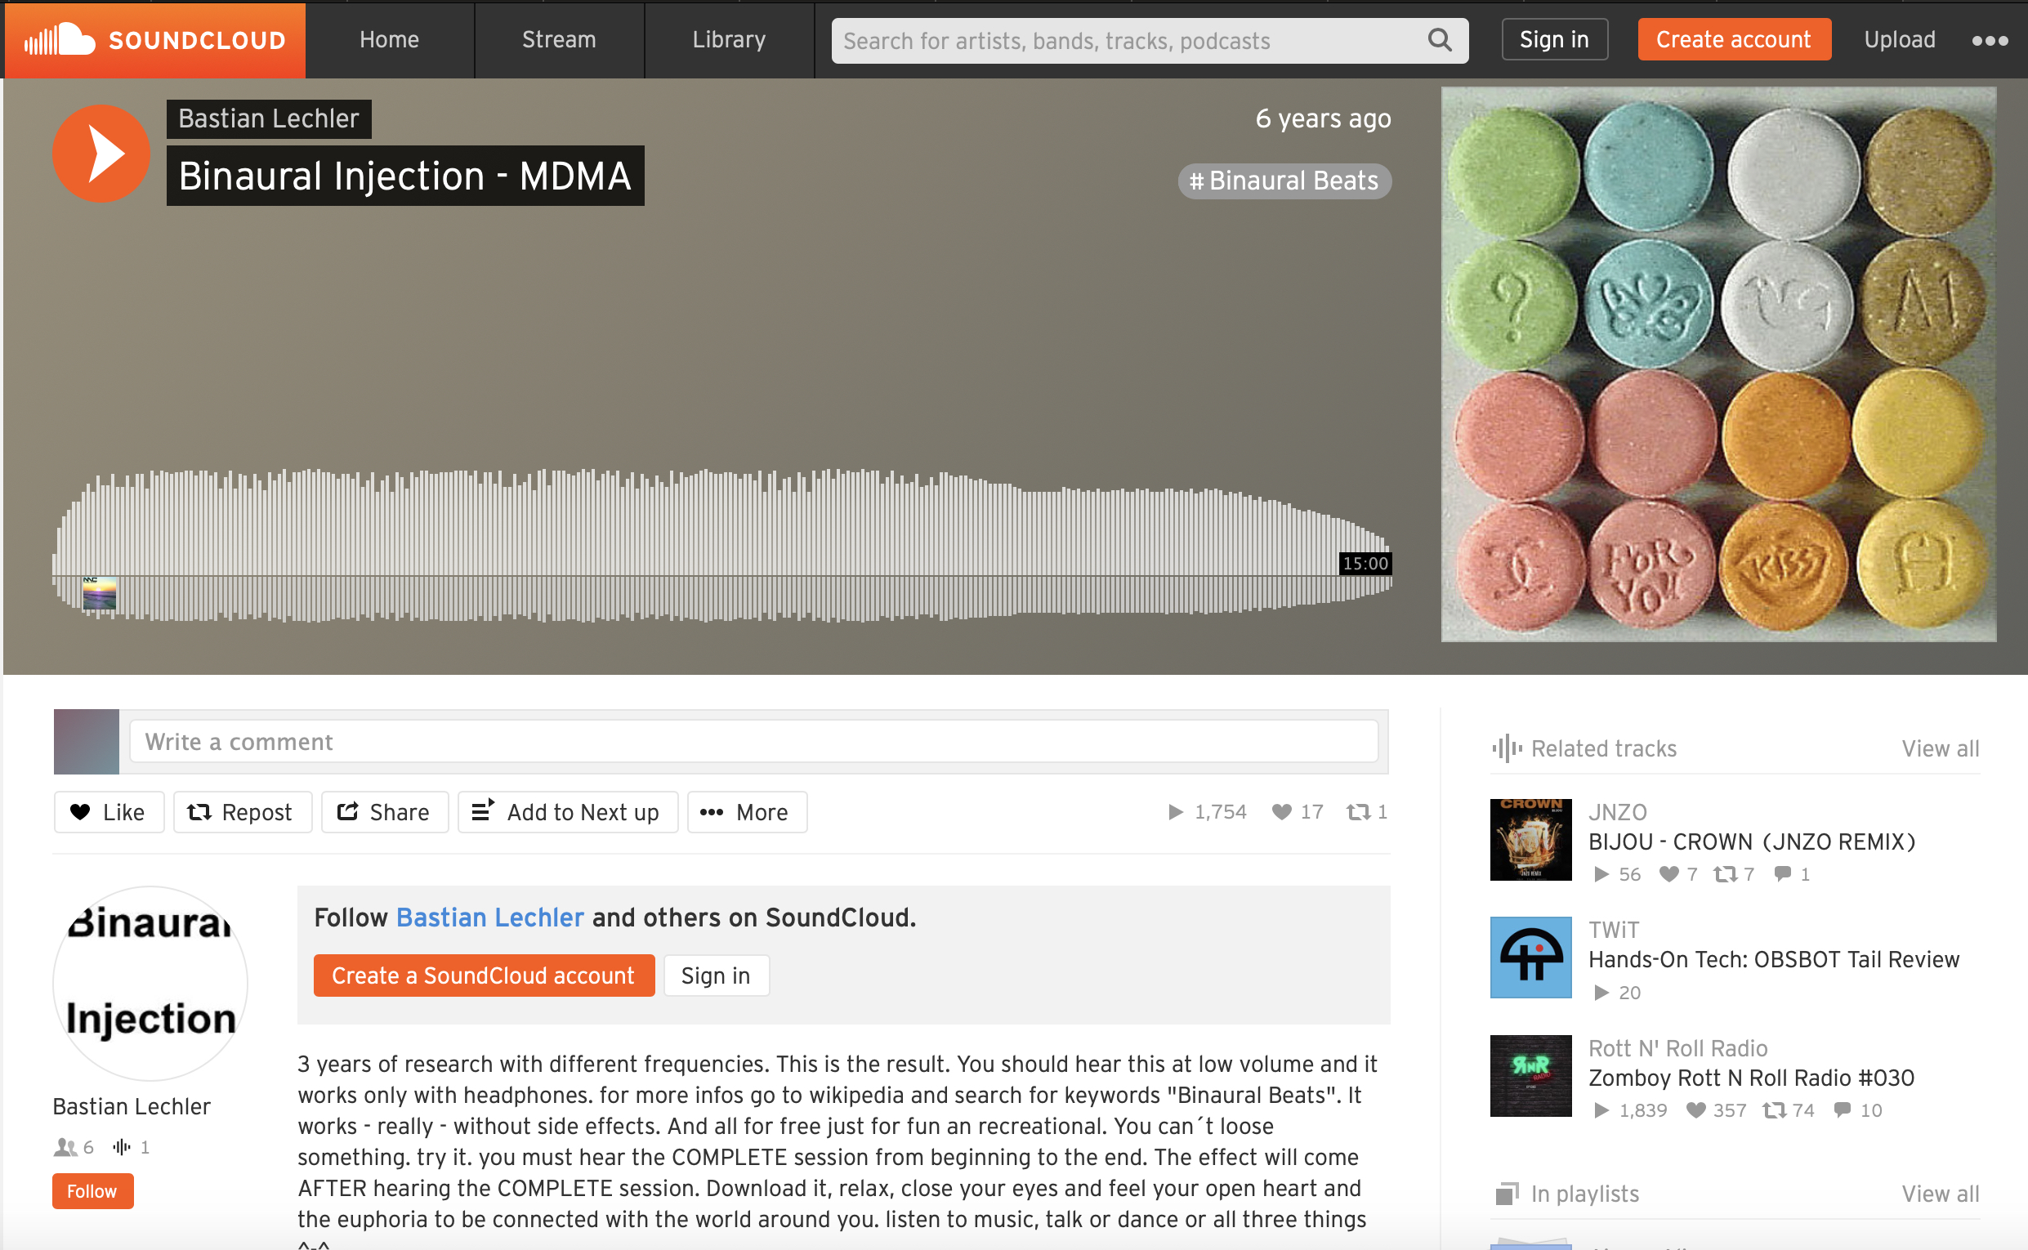
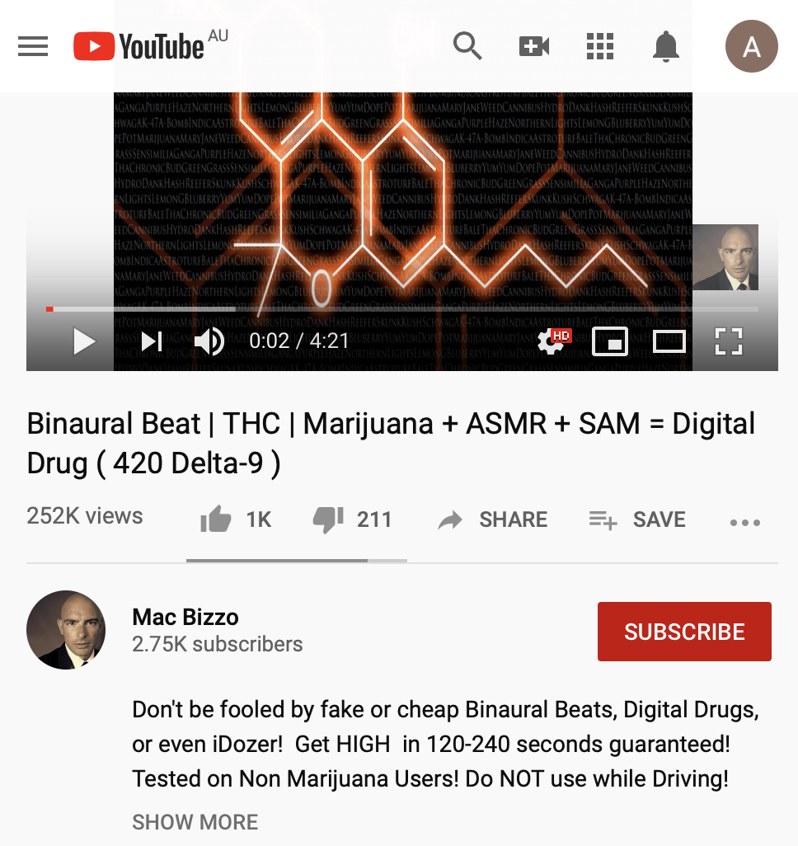
How do you get them?
We were introduced to digital drugs by a participant in our Silk Road research who created and uploaded tracks to Soundcloud.
Digital drugs can be accessed by social media music streaming apps such as Soundcloud, audio-visual social media such as YouTube and applications such as iTunes or Branded Apps.

Slide 6

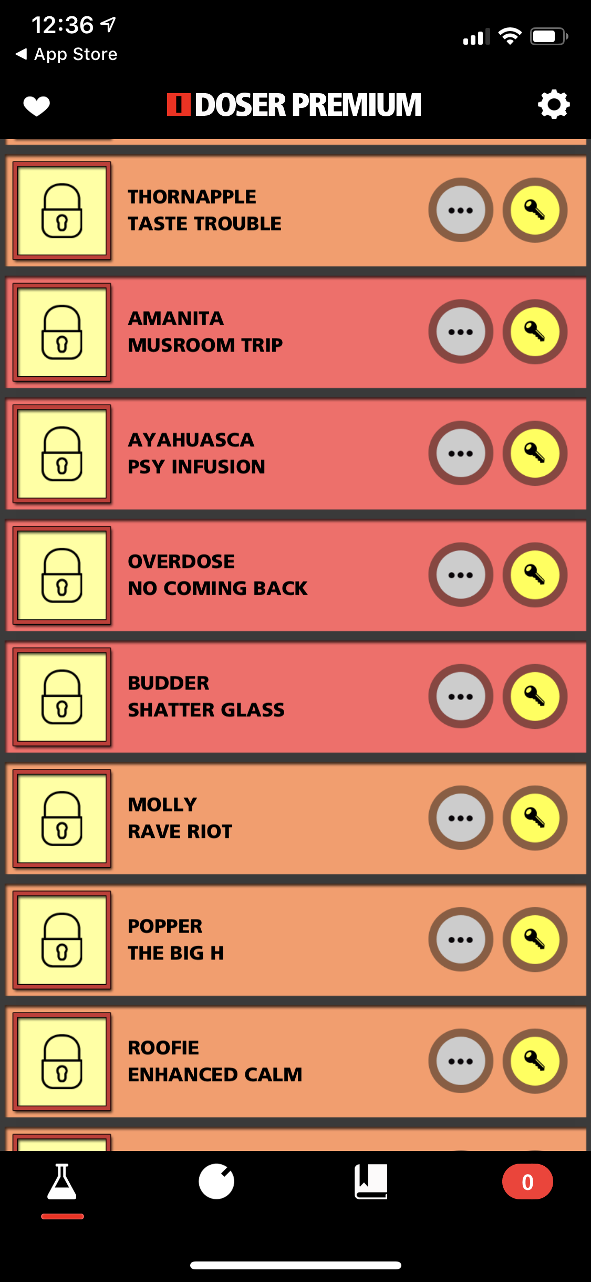
What is i-dosing?
The term i-dosing appears to be marketing terminology derived from the application,
I-Doser, which first launched in 2005.
I-Doser is an internet application for purchasing audio content that is claimed to simulate specific mental states through the use of binaural beats, some of which are named after prohibited recreational drugs.

Slide 7
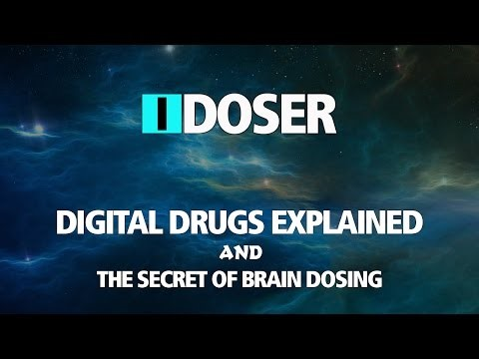

Slide 8
Binaural Beats create embodied effects
Listeners to binaural beats “hear” a beat
at a frequency equal to the difference between two tones beats played, one in each ear.
There is a👂 requirement for stereo listening 👂 for there to be an “effect”.
The listener will hear a psycho-acoustically engendered third tone which is purported to “entrain” brain waves and incite cognitive and mental states.
The third tone does not exist external to its listener, but only in the passage between the
body and audio object.

Slide 9
The digital-body instrument
The digital-body instrument that forms through the harmonisation of binaural beats accessed through an App or social media platform repositions the listener from user to prosumer.
The prosumer/produser) both consumes and produces the effect, as well as the content.
The body is central to creating the effect, however it cannot do this work without plugging in to digital content through audio technologies. (cyborg?)
From this position, we can examine the bodily practices of consumption in which the digital artefact and the body harmonise to evoke the pleasure of drug taking.

Slide 10
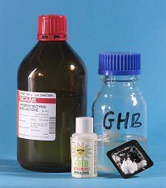
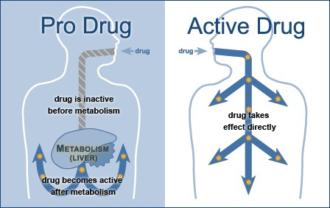
Drug Parallels
…The drug-body instrument?
GHB
  GHB (gamma hydroxybutyrate) is an anaesthetic that produces relaxant and euphoric effects. GBL (gamma butyrolactone) and 1,4-BD (1,4-butanediol) are chemicals that convert to GHB after they enter the body.
Pro-drugs
  A pro-drug is a medication or compound that, after administration, is metabolized (i.e., converted within the body) into a pharmacologically active drug. Inactive pro-drugs are pharmacologically inactive medications that are metabolized into an active form within the body.

Slide 11
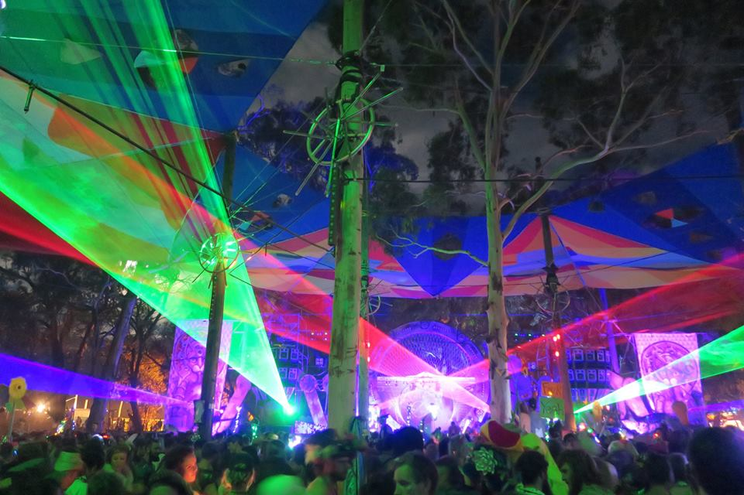
Drug ASSEMBLAGES
Cameron Duff ‘Health assemblages’ (2014) drawing on Deleuze
What kinds of associations, between what kinds of spaces, bodies and affects, produce what kinds of drug effects (and harms)?
katmeow, Rainbow Serpent Festival, Beaufort, Victoria, 2017

Slide 12
Having a teenager using an mp3 to listen to music and beats in the dark could be the introductory way to real narcotic abuse. Being able to detect, prevent and deal with this rapidly growing social evil is the responsibility of the healthcare system and community workers.
Fawzi & Mansouri (2017)

Slide 13

tHE POLITICS OF PLEASURE
Digital drugs evoke a moral panic on the basis of a loss of control by the state and collective institutions over the freedom of an individual to experience of pleasure.
Connecting the word ‘drug’ to binaural beats evokes questions of harmful effects and concerns about regulation that mirror contemporary (non-digital) drug discourses.
Digital drugs also provoke questions of trust in the platform, the privacy of the user, the authenticity of the experience and raises questions about surveillance and potential new forms of social control.

Slide 14
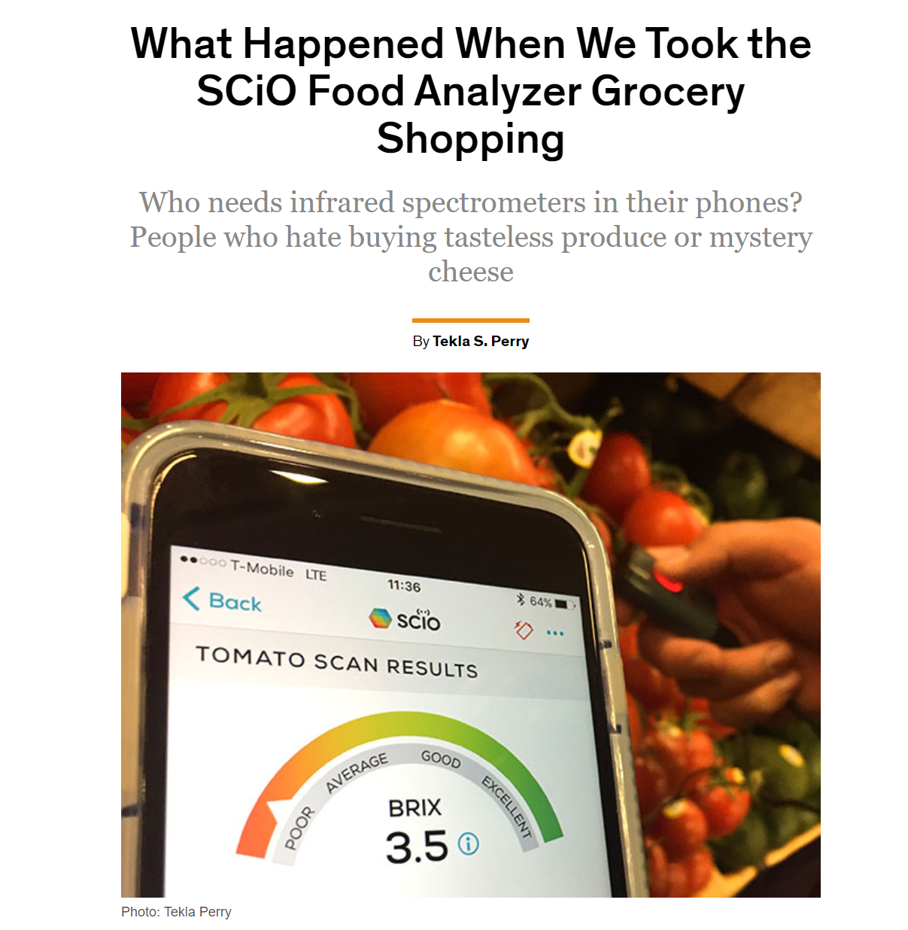
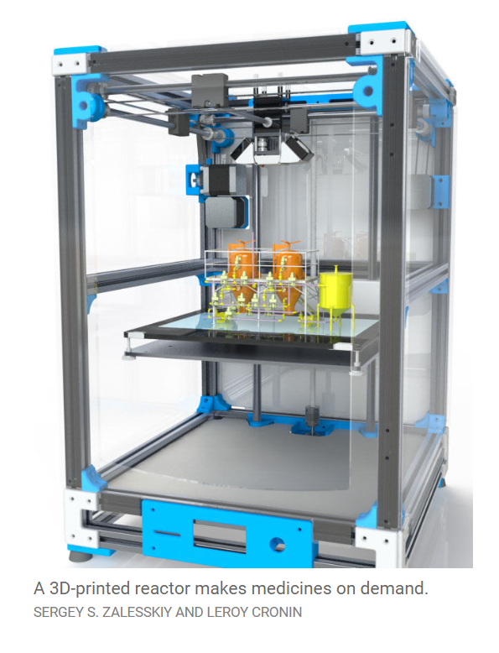
Digital Drug Futures … beyond digital audio

Slide 15
Download your drugs?
Alexia Maddox, Deakin, @alexiamadd
Monica Barratt, RMIT, @monicabarratt

